Slide 2
Don’t Make Me Feel Stupid A. User
Liam Westley
Application Architect
liam.westley@huddle.com
@westleyl

Slide 3
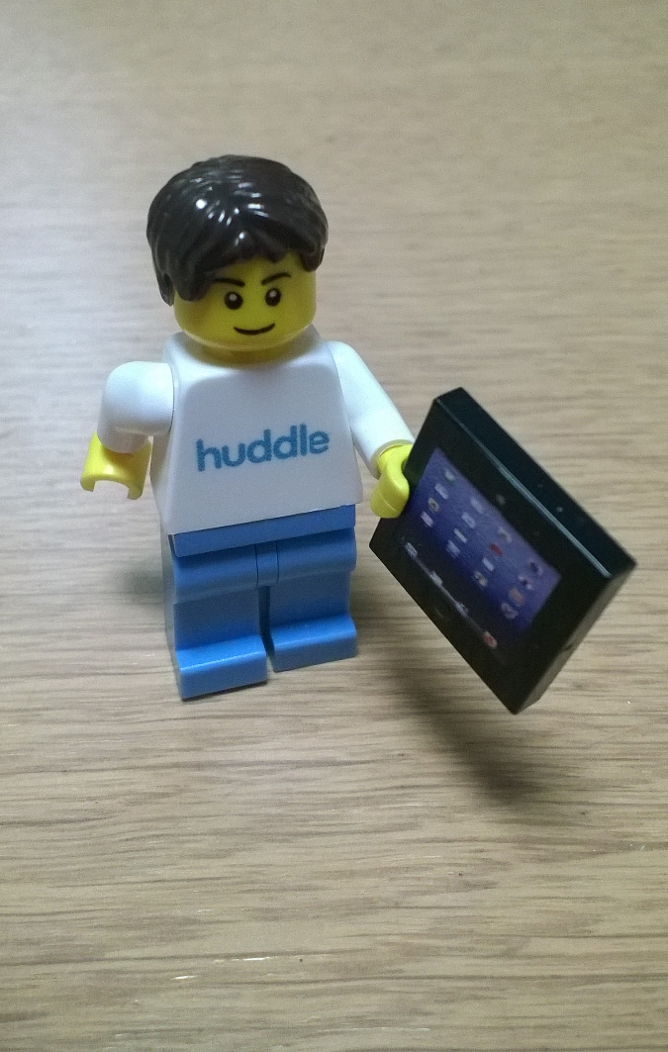
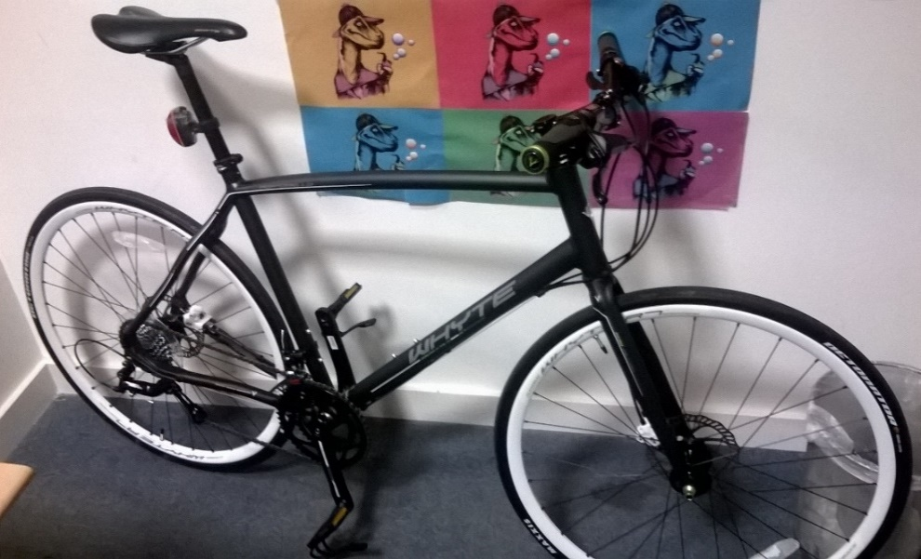
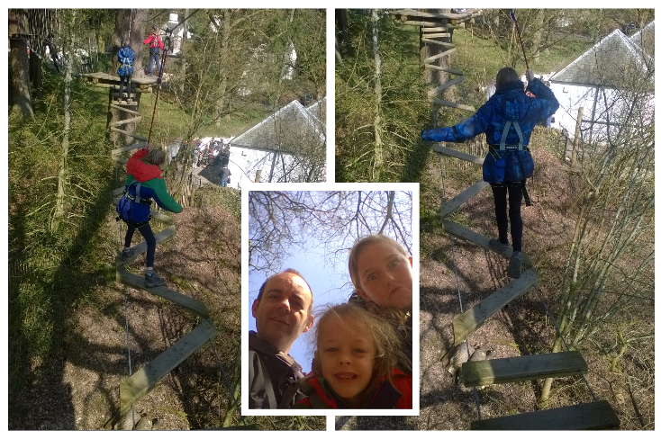
Who is Liam Westley?
< commute
play >
< work

Slide 4
Who is Liam Westley?
Possibly, more relevant, Liam is the application architect for the mobile and desktop teams at Huddle
iOS; iPhone and iPad applications
Android
Desktop Windows
Desktop OS/X
And he owns too many devices …
Windows Phone, Android phones (F to L) and tablets (Nexus 7 and 9), iPad mini, Windows; laptops, 10” and 7” tablets, Kindle ….

Slide 5
‘Two roads diverged in a wood, and I -
I took the one less travelled by,
And that has made all the difference.’
The Road Not Taken
Robert Frost, 1920

Slide 6
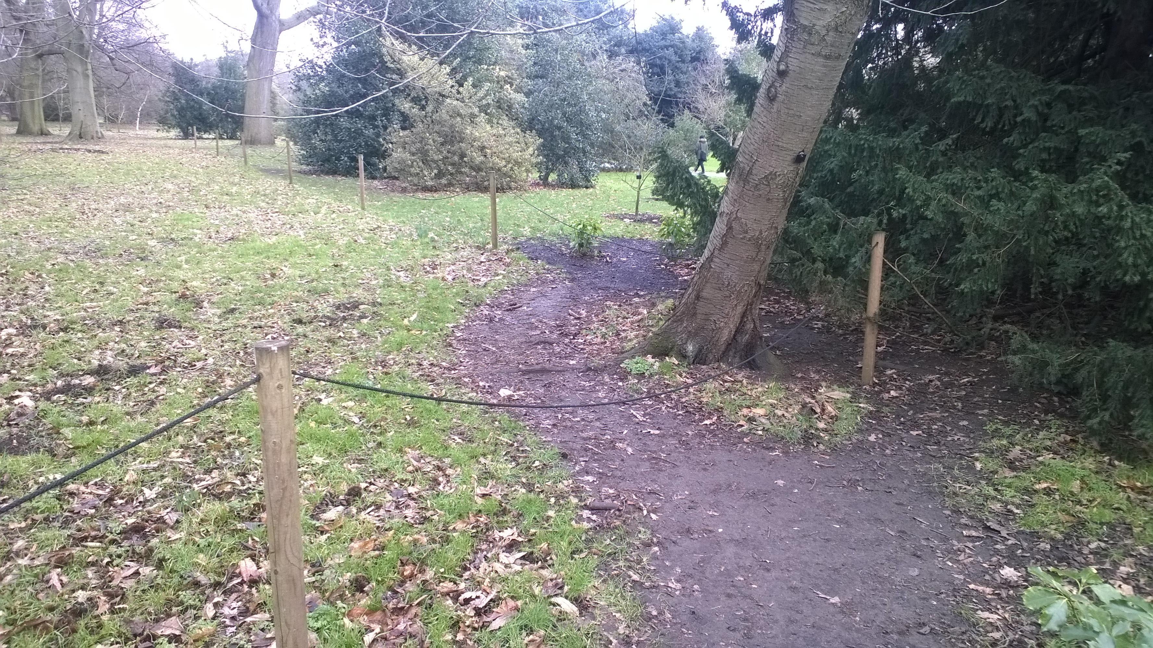
This is not the path you are looking for …

Slide 7
This is not the path you are looking for …
But it might be … it might just not the path that Kew Gardens wants you to use?
Maybe … they should build a path here?
… or is it indicating that they should improve the path they would like you to use?

Slide 8
More than one path
Multiple paths are OK
If you don’t build it, be ready for users to try to build it
Users don’t think like developers
Regional variations
Notes:
Multiple paths are OK
think of Microsoft Word – File+Print, Ctrl+P, Print icon – all can print a document
If you don’t build it
Twitter originally didn’t have a retweet functionality
users defined RT as a retweet, and it’s still in use today
Normal users don’t think like developers*
they don’t even think like each other
think how everyone might use your software and prioritise the most important categories
* unless it’s a developer tool, but even developers have a habit of disagreeing ☺
UX can also be regional (need examples), beyond date format, text direction. Metaphors and colours may not mean the same everywhere.
GET ATTENDEES TO CHECK UNDER THEIR SEATS

Slide 9
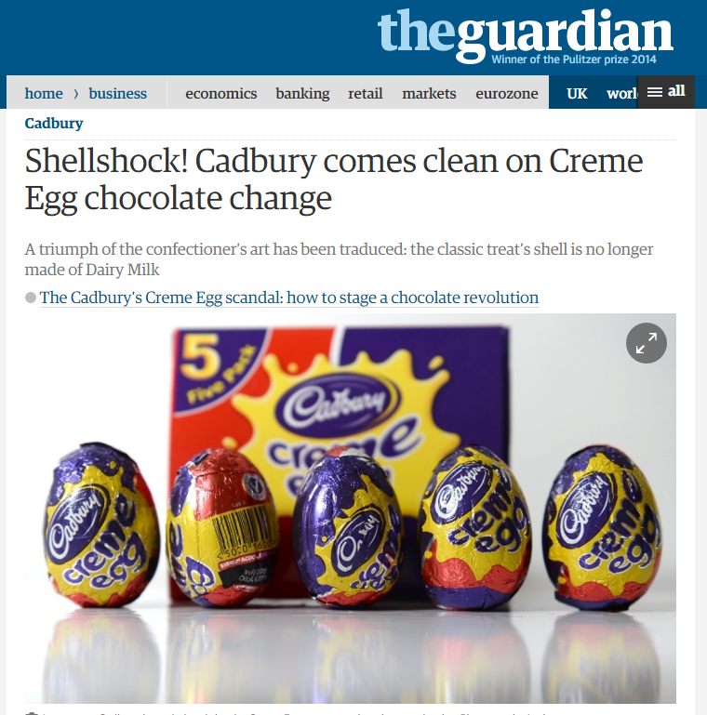
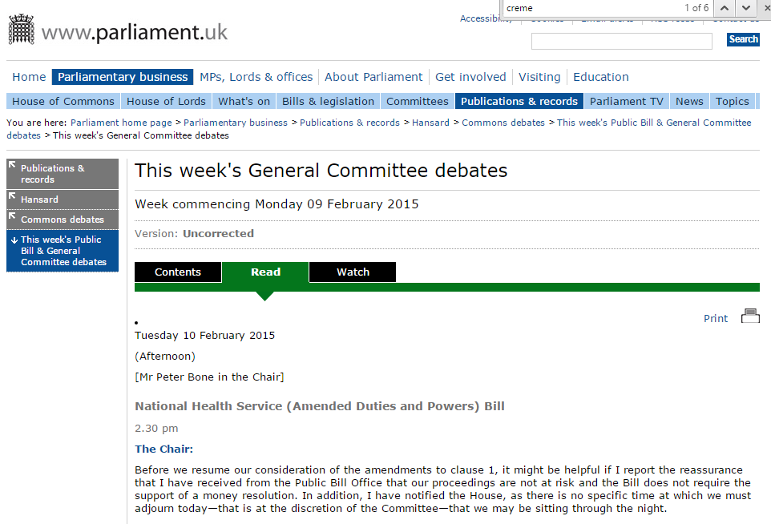
Regional UX … the UK is horrified
Notes:
[Hand out crème eggs]
Regional UX – Family Names (Surnames), handy in Western concepts, but not used in other cultures. Also, colours and icons don’t always have the same meaning either.
http://www.theguardian.com/business/2015/jan/12/shellshock-cadbury-comes-clean-on-creme-egg-chocolate-change
Enough to get mentioned in parliamentary committees;
http://www.parliament.uk/business/publications/hansard/commons/this-weeks-public-bill-general-committee-debates/read/?date=2015-02-10&itemId=1088

Slide 10
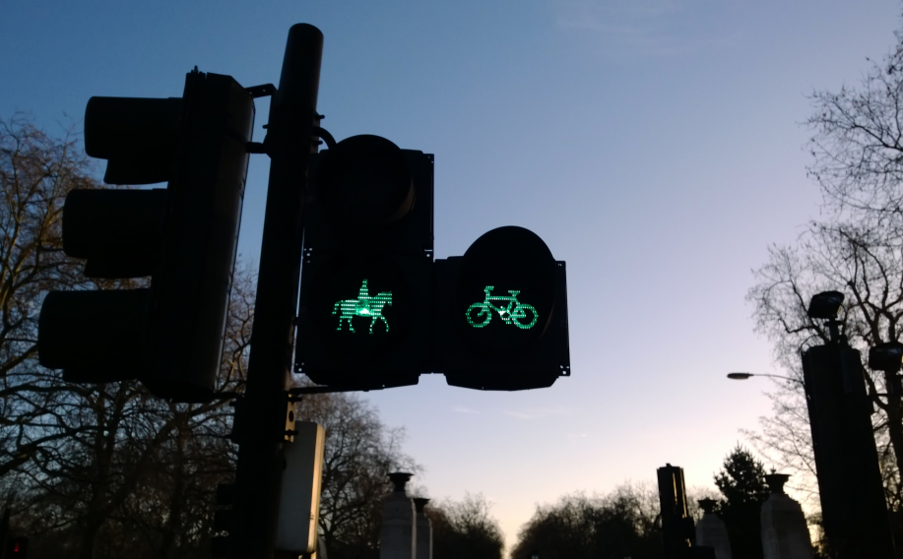
Embrace the different paths
Notes:
* unless it’s a developer tool, but even developers have a habit of disagreeing ☺
TODO - UX can also be regional (need examples), beyond date format, text direction. Metaphors and colours may not mean the same everywhere.

Slide 11
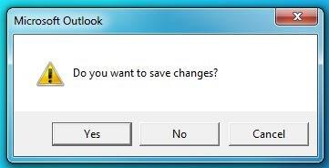
Notes:
You might have seen this, when you close Outlook, you have an unsaved e-mail and it pops up this message. It’s great, I can Cancel and head back to see what I changed in the e-mail.
…. which is great, unless you close down the machine, which closes Outlook, which throws up this dialog, but you can’t go back to view the e-mail that’s changed, Cancel doesn’t work. You just have to click Yes because, you have NO IDEA what you might be losing.
YOU SHOULD NEVER HAVE BEEN ASKED – IT SHOULD HAVE SAVED CHANGES AS DRAFTS BECAUSE IT’S THE ONLY SENSIBLE THING TO DO. REALLY. I MEAN REALLY.
I MEAN WHO LET THIS OUT IN THE FINISHED CODE?

Slide 12
Don’t force users to make pointless choices
Outlook closing dialog
Yes - save
No - discard changes
Cancel - review what changed
But what happens when you close down Windows?
Cancel does not allow you to go back, as the main Outlook window has already closed.
Notes:
Outlook closing dialog
A sensible dialog from Outlook, when you exit, letting you know you have an unsaved e-mail or calendar appointment
Closing Windows
This closes down Outlook, closing main window, but Cancel is now completely pointless
The same dialog, but completely unusable.
IMHO – Just save as drafts (for e-mail) and maybe even as drafts for other unsaved items, and mention to user the next time they start.

Slide 13
Don’t force users to make pointless choices
Cash machine (ATM)
You are shown a menu; €20, €30, €40, €50, €100
You request €30
To be told, there are no €10 notes, and have to enter a manual amount
IT KNEW THERE WERE NO €10 NOTES
AND IT DIDN’T CARE
Notes:
The ATM issue is a classic issue of making a user feel stupid.

Slide 14
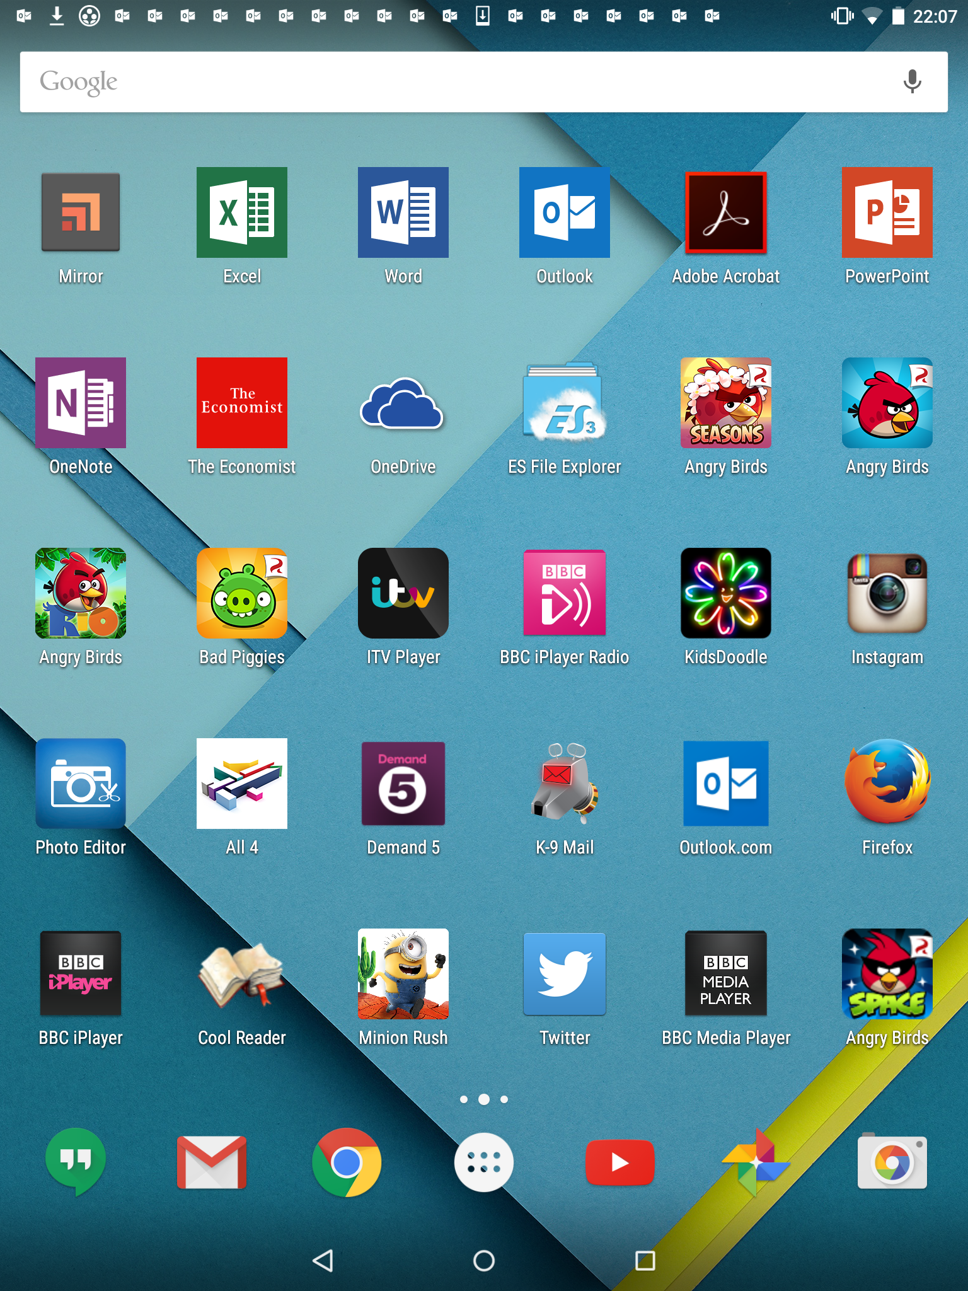
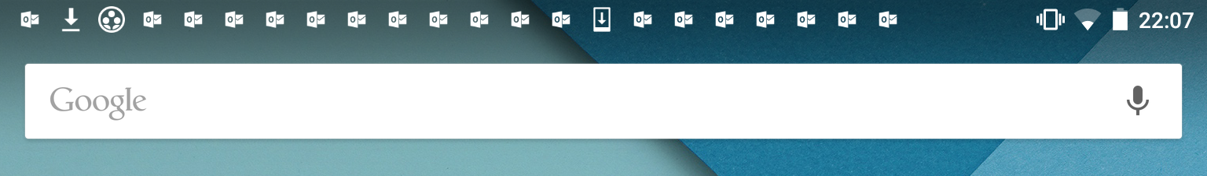
Too much information?
Wow – There must be something really important going on!
Notes:
Nexus 9 running Android Lollipop

Slide 15
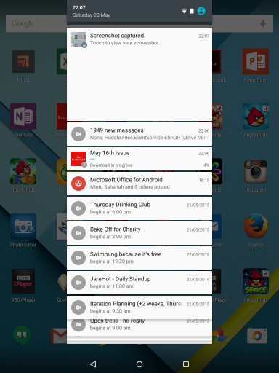
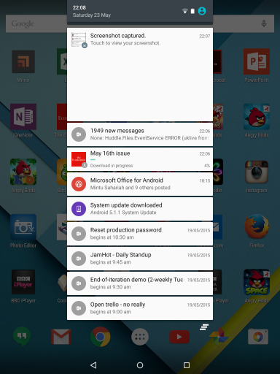
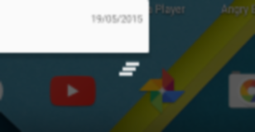
Too much information - overload
Oh no, it’s just some calendar reminders …
… and no way to clear them all easily.

Slide 16
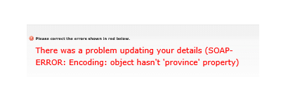
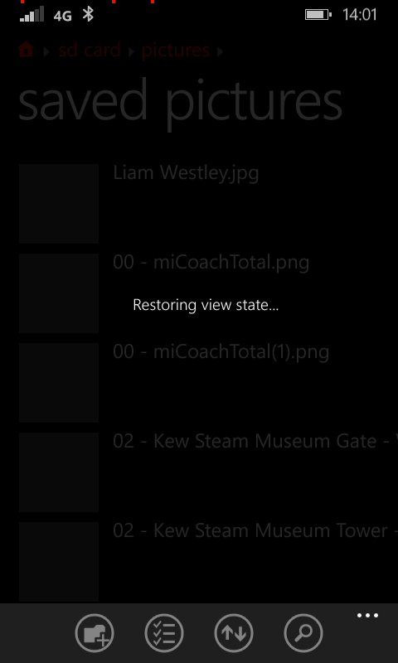
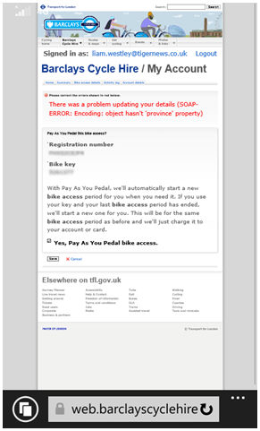
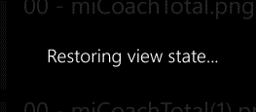
Too much information - geeky

Slide 17
Too much information
Don’t spam users with too much information
Too many confirmation dialogs trigger auto acceptance
Be careful with ‘geeky’ terminology
Notes:
Don’t spam
Notifications can become like e-mail spam, and will get ignored
Users will switch off your notifications on mobile devices for badly behaved applications
Geeky messaging
At best it can be incomprehensible, at worst, intimidating
All professions have their own language and terminology – think how much you enjoy reading a legal contract

Slide 18
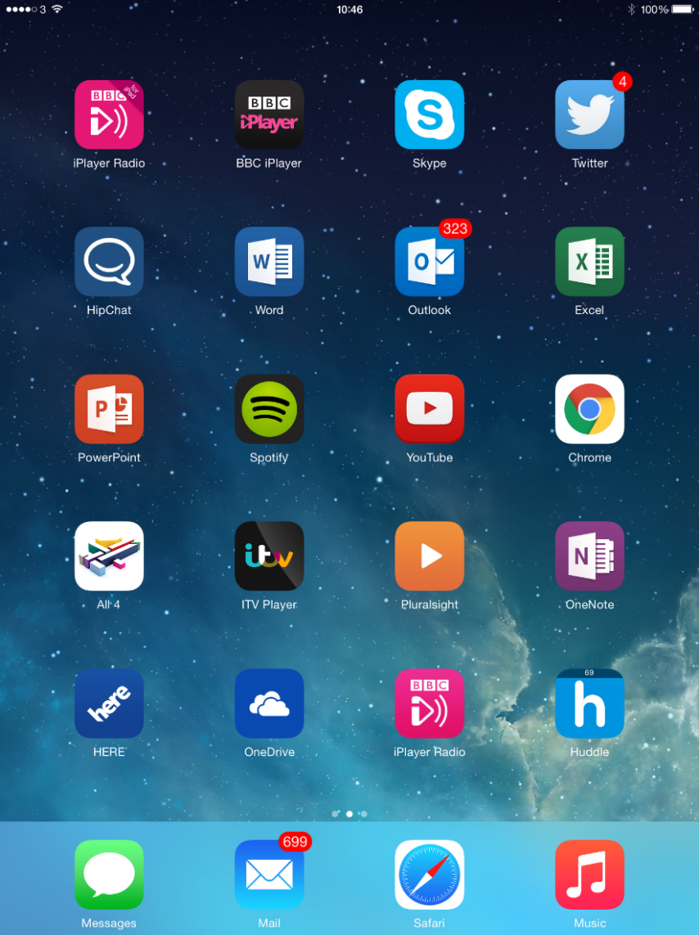
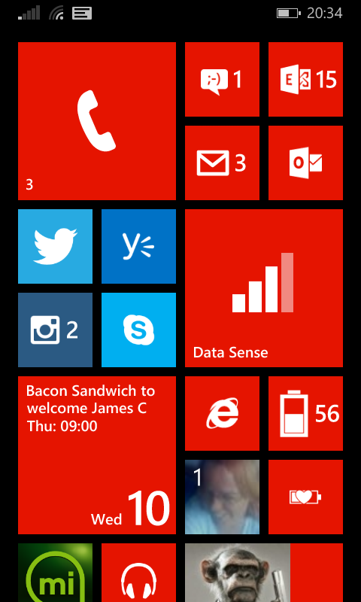
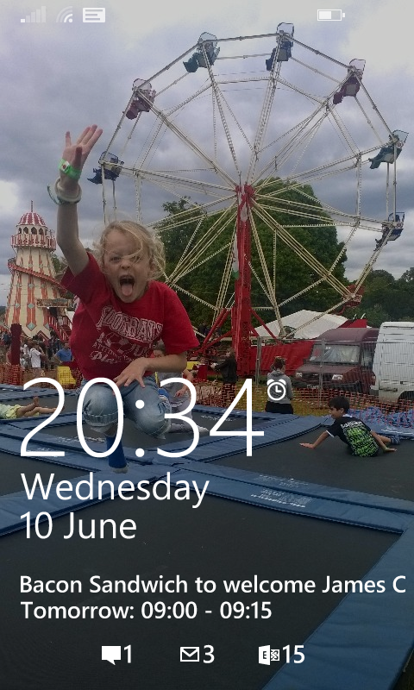
Too much information - solved

Slide 19
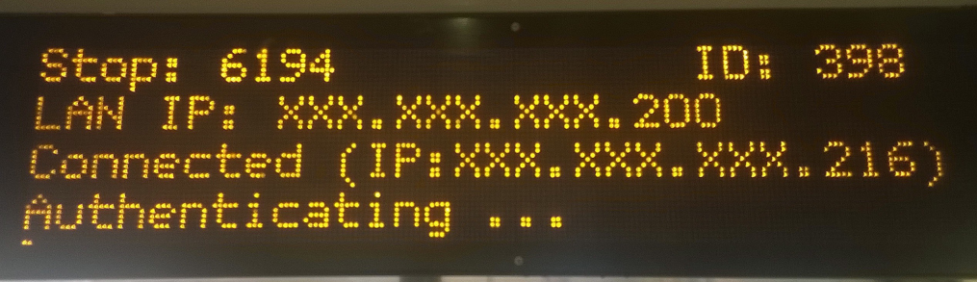
Too much information - very geeky
Notes:
And here is my bus stop in London, rebooting, and letting me know it’s IP address.

Slide 20
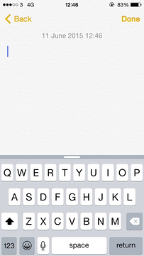
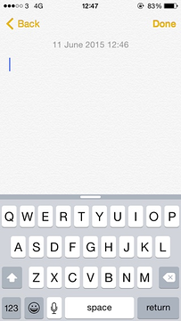
Too little information

Slide 21
Too little information
iOS keyboard – personal bug bear
Outlook stupid dialog … again
Too little information causes people to navigate further through an application, or forces people to think
Notes:
Outlook dialog
With no e-mail title, or calendar details, you really don’t know what you might be saving
iOS keyboard
An attempt to be skeuomorphic and replicate a real world keyboard?
This means it doesn’t take advantage of the ability for an on screen keyboard to show if it is in lower or upper case
FIXED IN iOS9

Slide 22
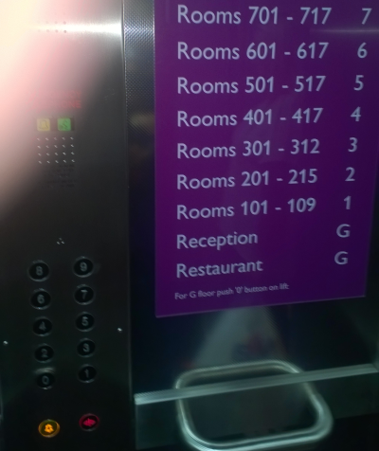
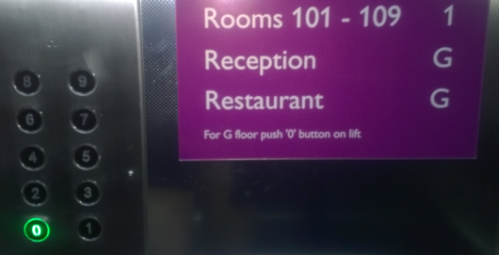
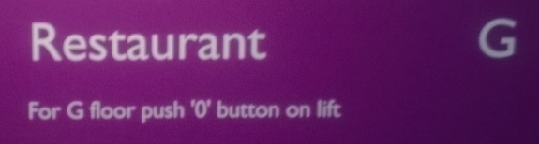
Consistency
Notes:
Hotel in Leeds at DDD North conference. Whoever makes the signs disagrees with whoever makes the lifts.

Slide 23
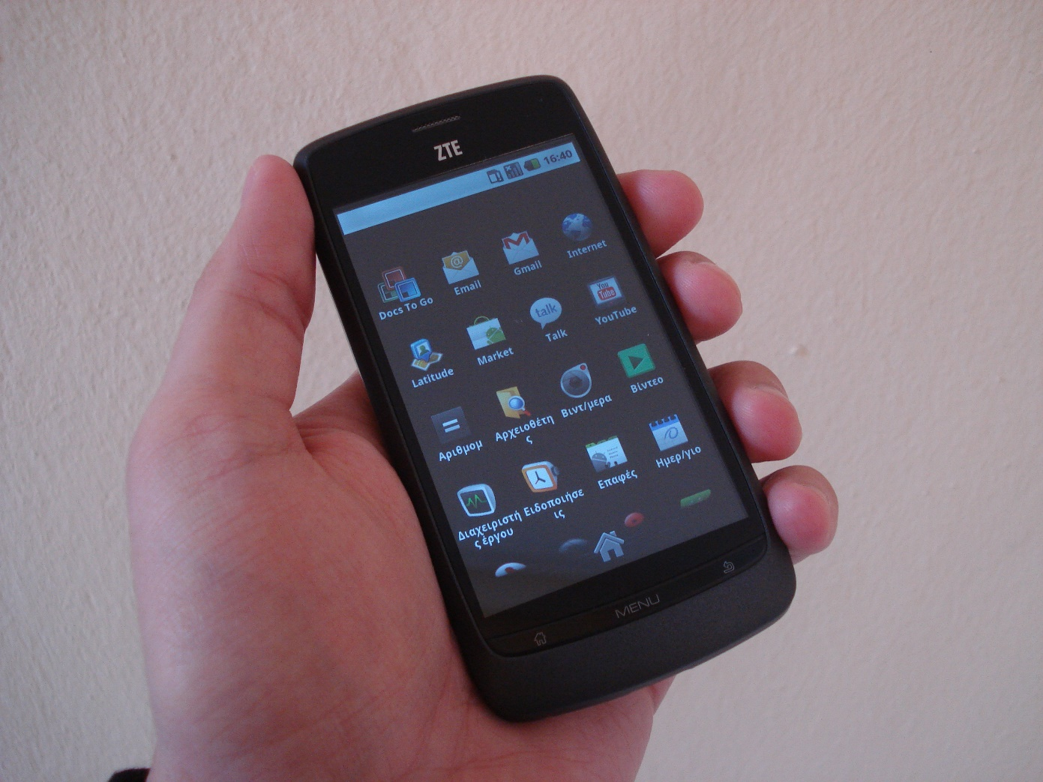
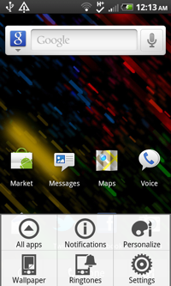
Android settings … Gingerbread (ZTE Blade)
Notes:
Click the physical MENU button on the home screen and you get a settings cog icon.

Slide 24
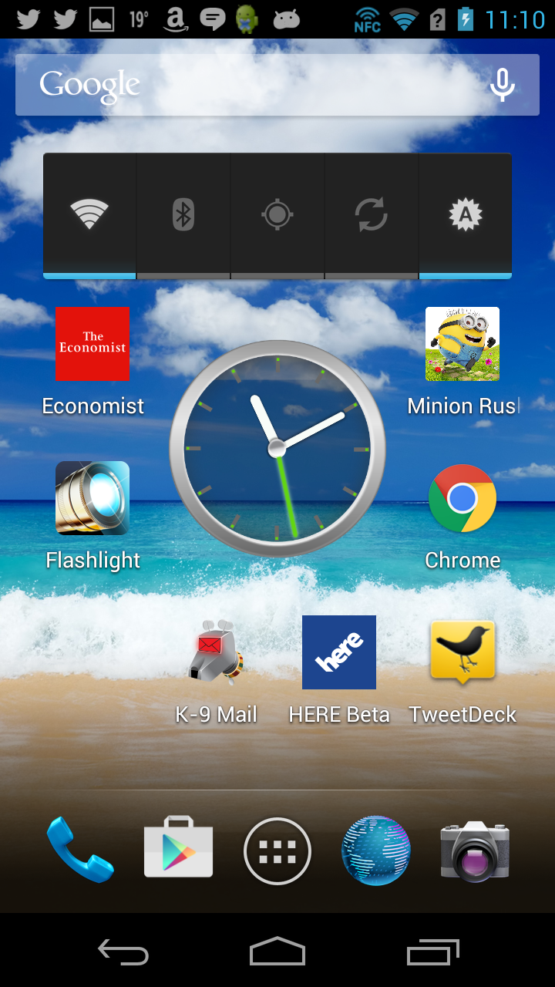
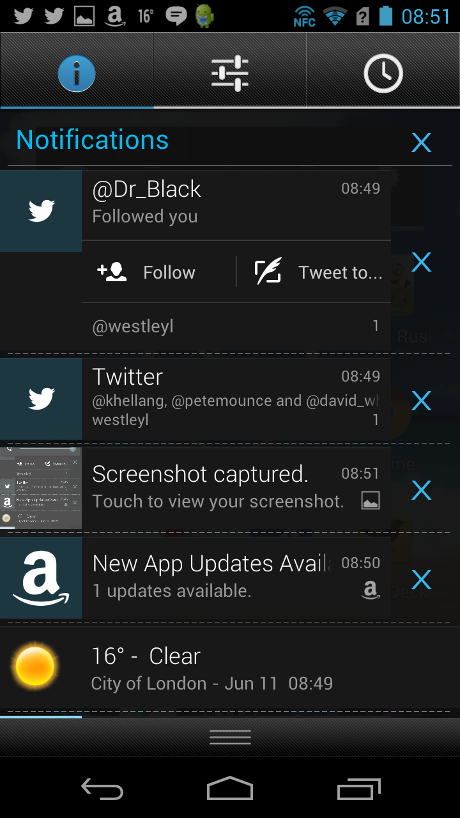
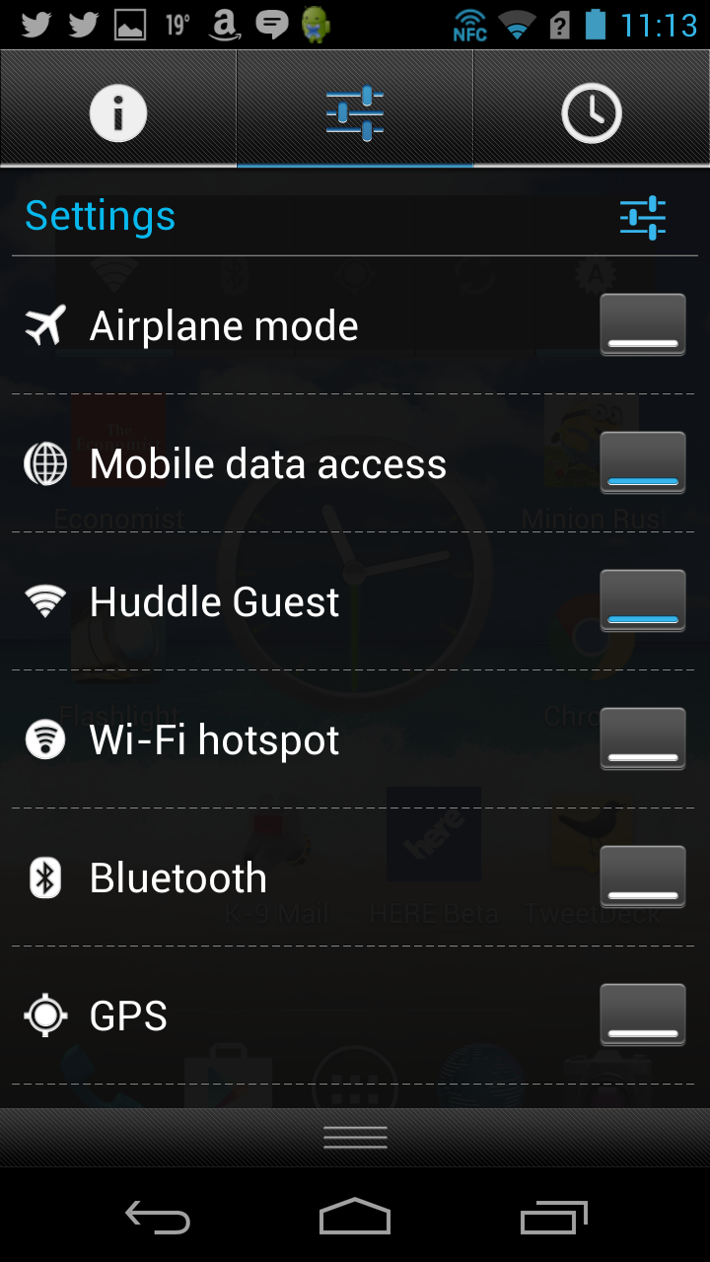
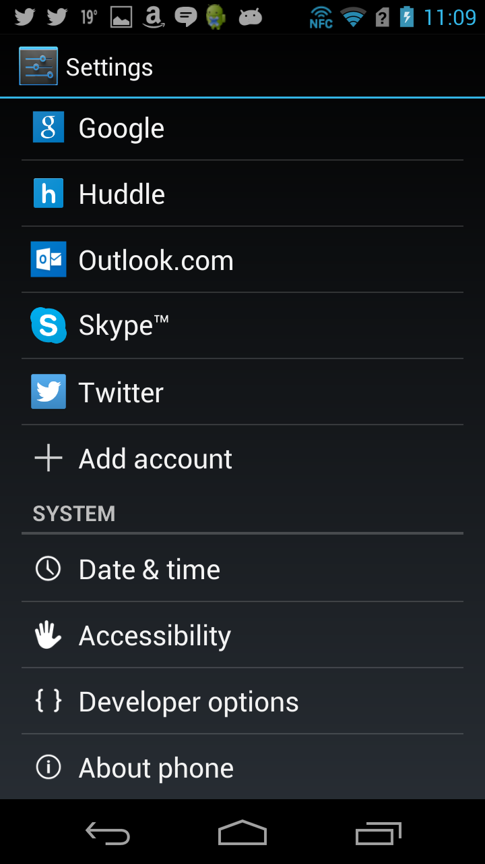
Android settings … Jellybean (Acer S500)
Notes:
Swipe down from anywhere, settings is now a graphic equaliser, no longer a cog.

Slide 25
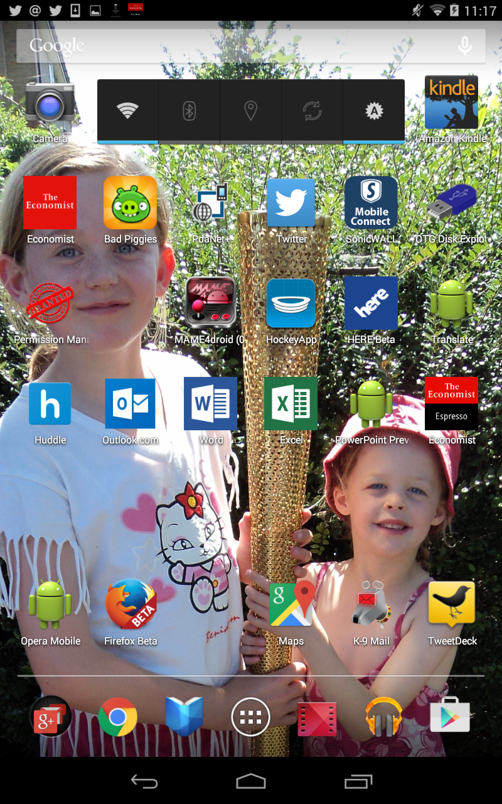
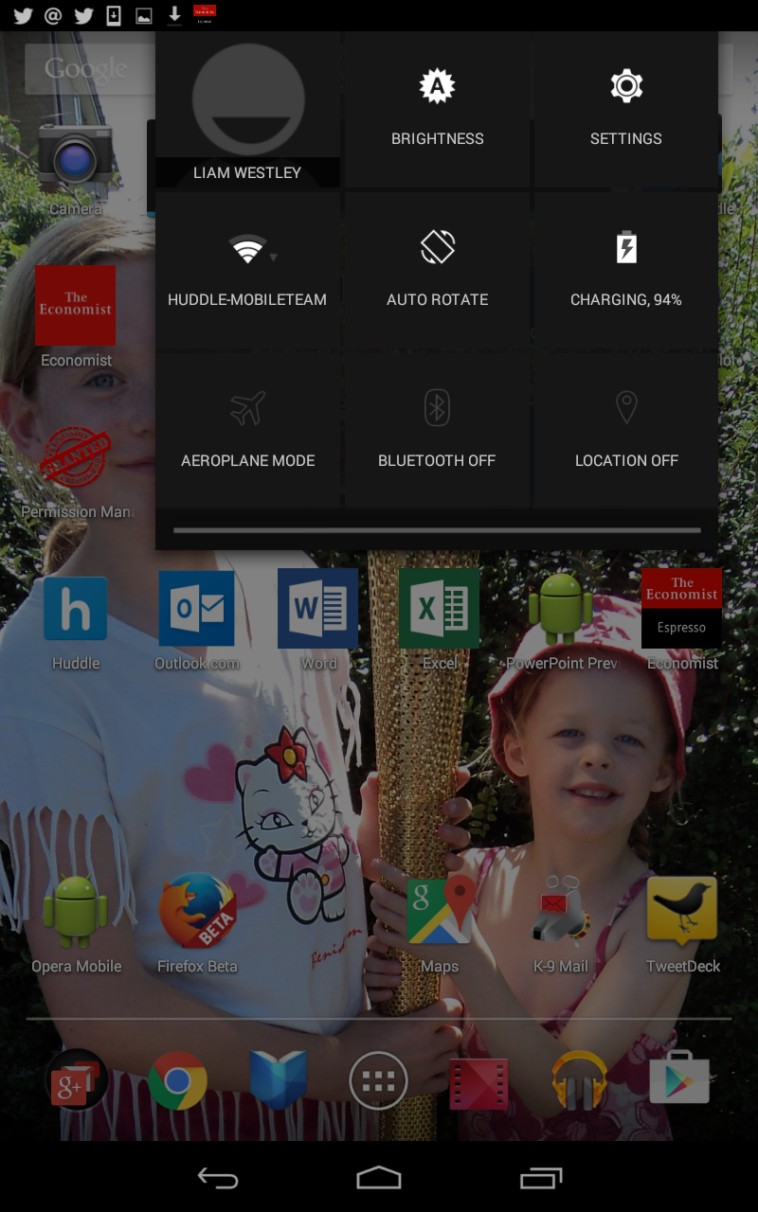
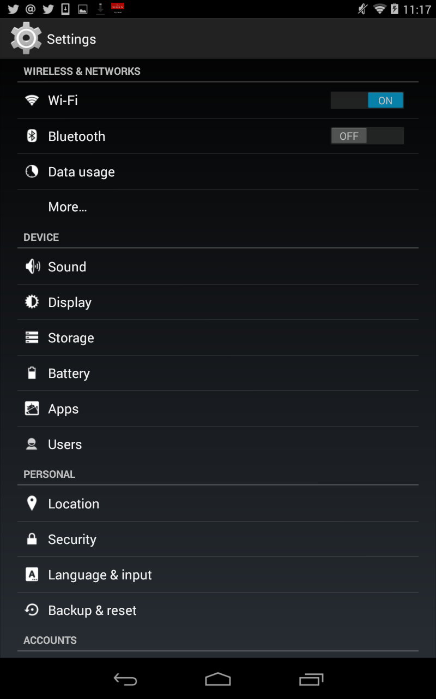
Android settings … KitKat (Nexus 7)
Notes:
Note: swipe down MUST be on right hand top area, it’s back to a cog from an equalizer.

Slide 26
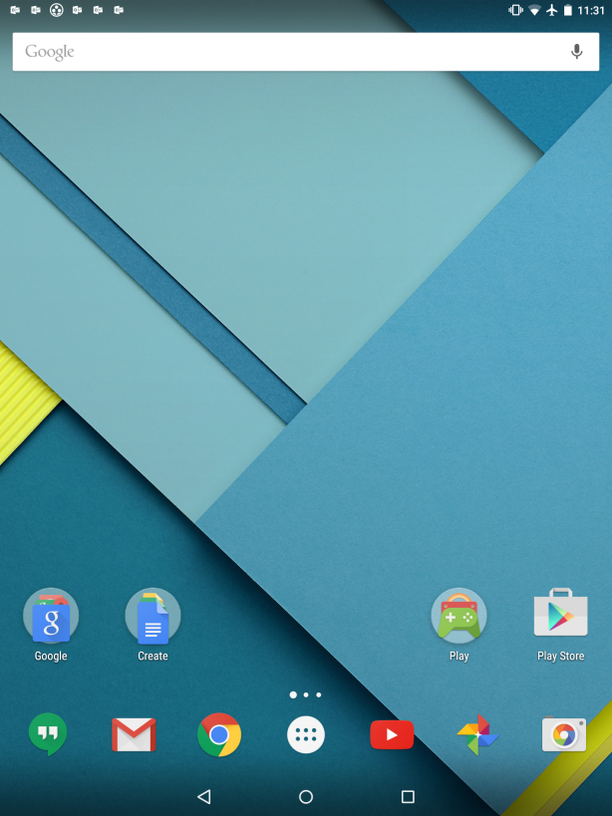
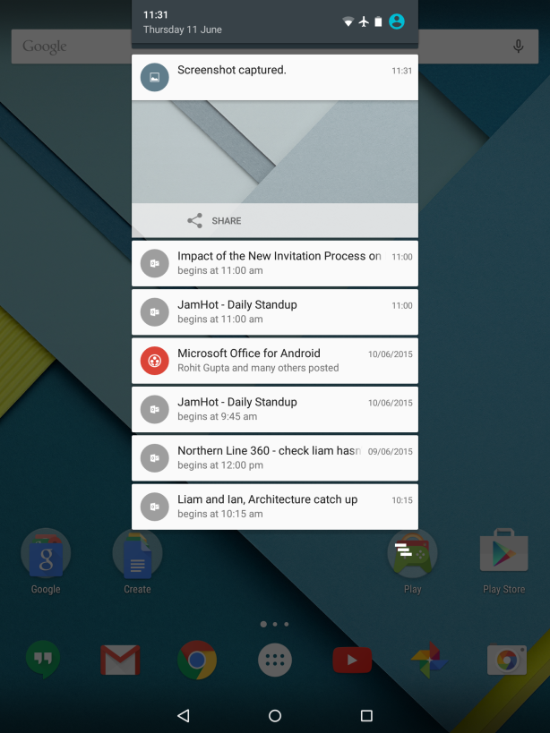
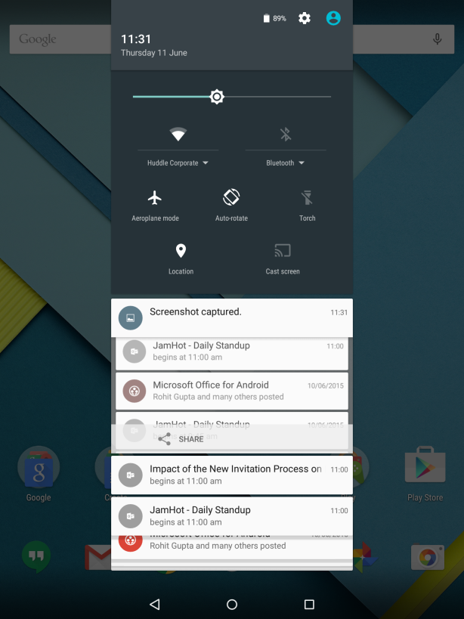
Android settings … Lollipop (Nexus 9)
Notes:
Note: swipe down back to being anywhere on top area, and brings up notification pane, which you can click near the top left, to show the settings cog which you can now click on.

Slide 27
Consistency
Hotel lift, 0 on button, G on notice.
Android settings - who moved my cheese?
Ctl+F in Outlook
Be careful with accelerator keys in browsers
Notes:
Hotel lift
other real world examples; doors with PUSH and PULL on them
Who moved my cheese?
Think about what your changes might do to existing users, like Android settings
Change can be good, and users can be happy with them, if you help them understand what has changed; in app tours really help here.
Ctl+F in Outlook
No way should this forward a message, really. I mean really. Apparently this was a feature request – Google it to find out who request it!
Browser shortcut keys
Alt+F in a browser brings up the File menu
unless you have a Youtube video, they sensibly use the F key for Full Screen, but didn’t check for a modifier key, so override Alt+F as well

Slide 28
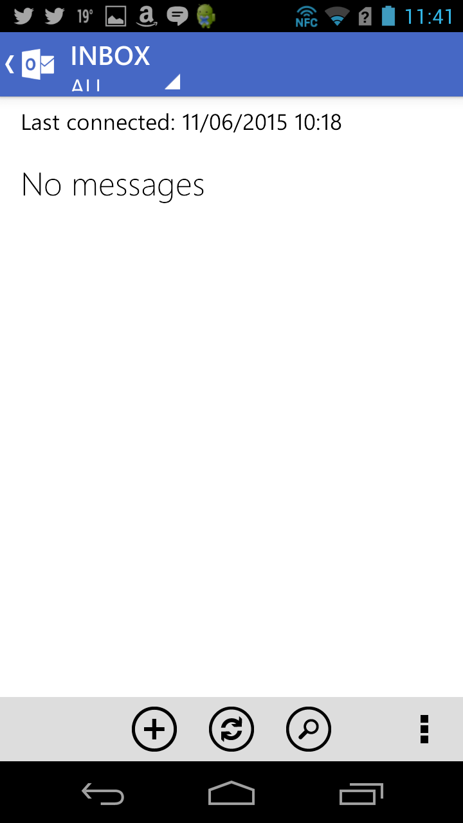
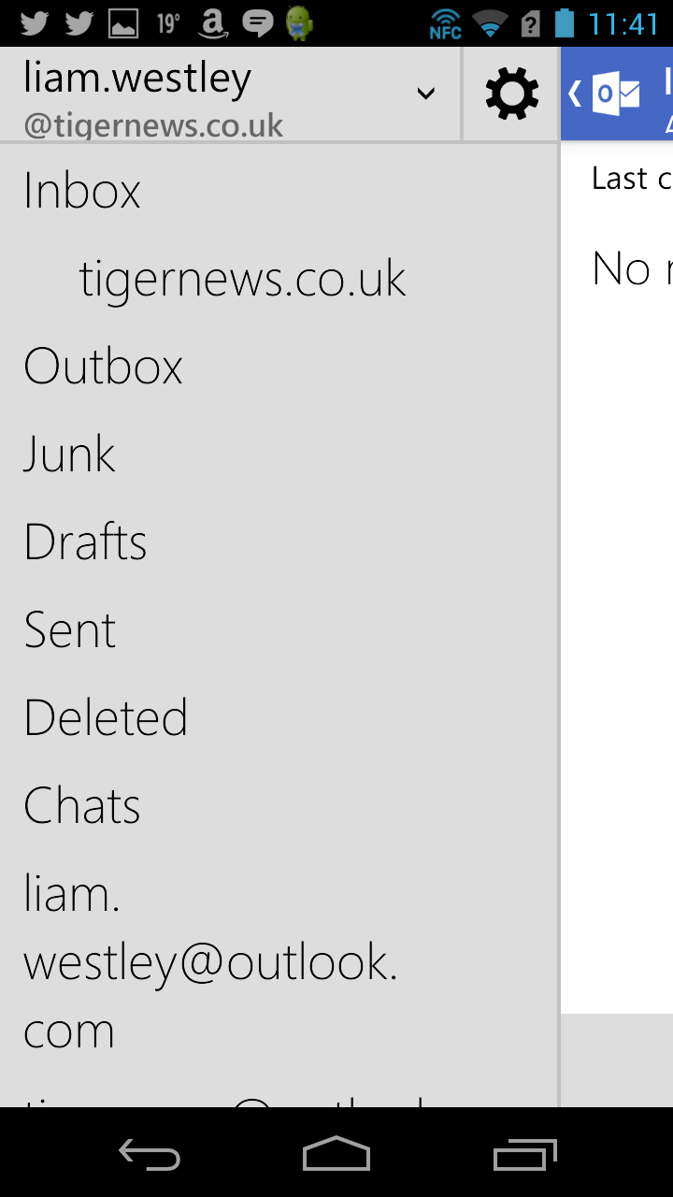
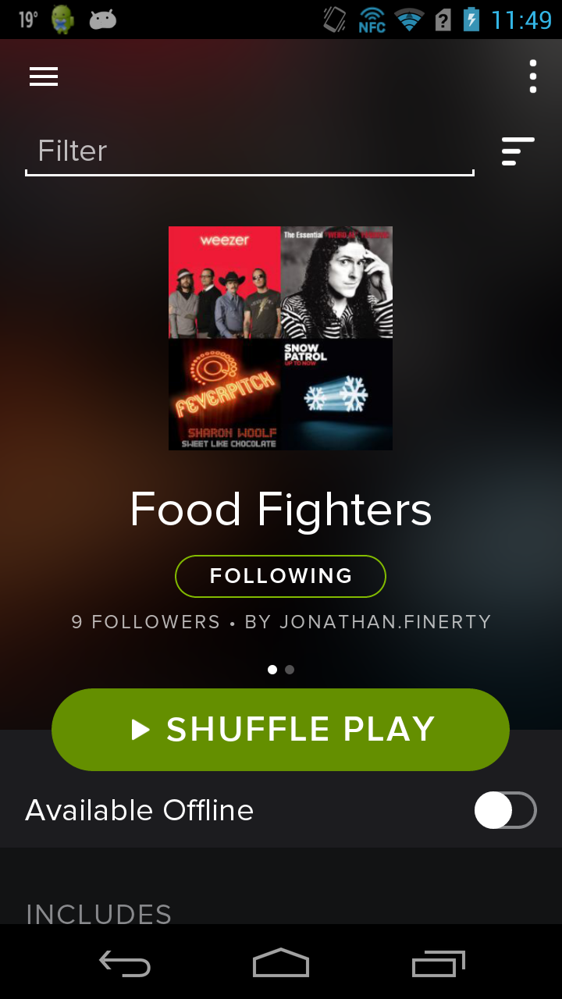
Consistency – application or platform
BAD
GOOD
Notes:
This is a IMHO – while it’s clear Outlook.com implementing a Windows Phone look and feel on Android is very wrong, you could argue that Spotify should use standard Android controls, but anyone who uses Spotify across multiple platforms; mobile, desktop, web …. this makes more sense.

Slide 29
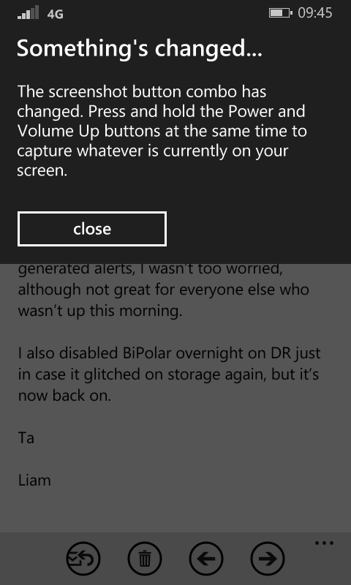
Surprise your user
The screen capture button changed in Windows Phone 8.1 so now, every time you press the old combination you see this help screen.
Notes:
If you do move someone’s cheese – let them know where it now is.

Slide 30
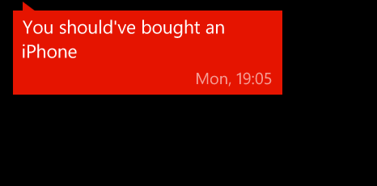
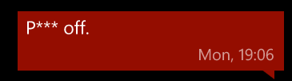
Surprise your user – Siri and Cortana
Notes:
When I was accidently triggering Cortana by holding down the search button on my Windows Phone, a colleague used Siri (took him three attempts) to send me a text message, I replied with ‘Piss off’ (in one attempt – lol), however, it was automatically edited before sending the text.

Slide 31
Surprise your user
Good – Smart handling of High and Low dates
Good – Search for a user
Bad surprise – beware the ‘days in March’
Notes:
Good – dates
Nag to correct, swap and execute OR swap and ask – depends on what you are doing (destructive or non destructive)
Timesheets in NHS, adjusted start day, and number of weeks
Good – search for a user
search by name and postcode
Auto fill if new
If one user go to that user
If more users then show list, allow user to pick, or add new with auto fill
Bad – BA and SAS web sites, booking return in March with same day of week / day of month as February
If you book your flight out in a February with 28 days
… then March has the days of the week on the same days of the month
Easy to book return flight in the wrong month; I did it, someone else did it with SAS – we spotted it and cancelled
Another friend did it with the same flight as BA, they didn’t spot it - £1,500 cost to get home

Slide 32
Get friendly with your designer
If designers should cope with technical concepts
in return we owe them a duty to understand design
Affordance
provide a guiding hand to users
Developers are the gatekeepers
we can and should question design decisions
Notes:
Technical concepts
Who here has read a legal contract – how much fun was it? All professions have a technical language, devs and designers should share their professional languages
Affordance
The handles on a tea set provide an obvious affordance for holding.
Plate and Handle on a door, are the hints to push / pull a door.
Developers as gatekeepers
It was a designer who emphasised how important they are to ensure designs are consistent and usable

Slide 33
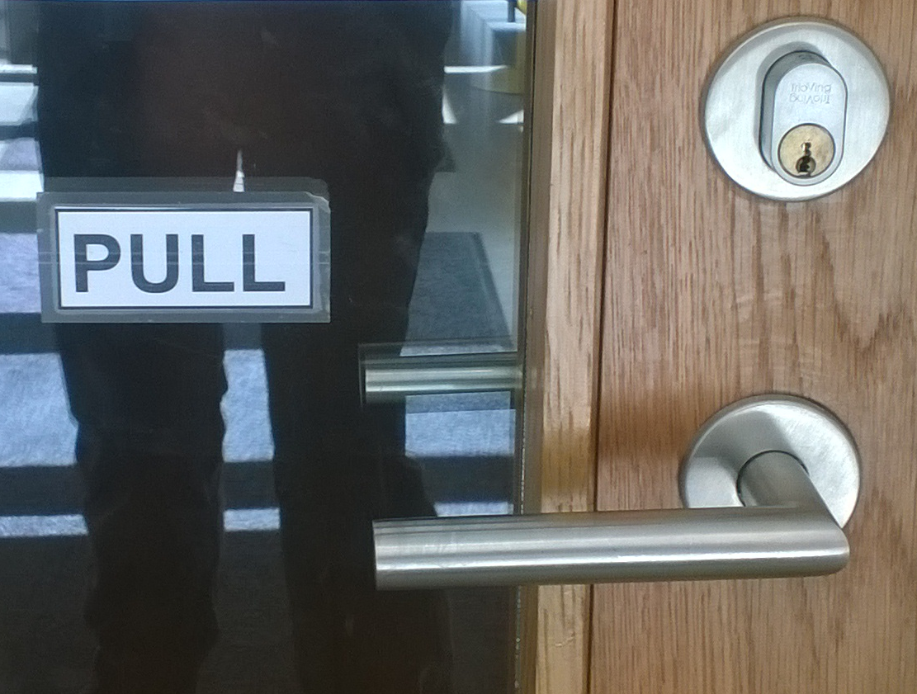
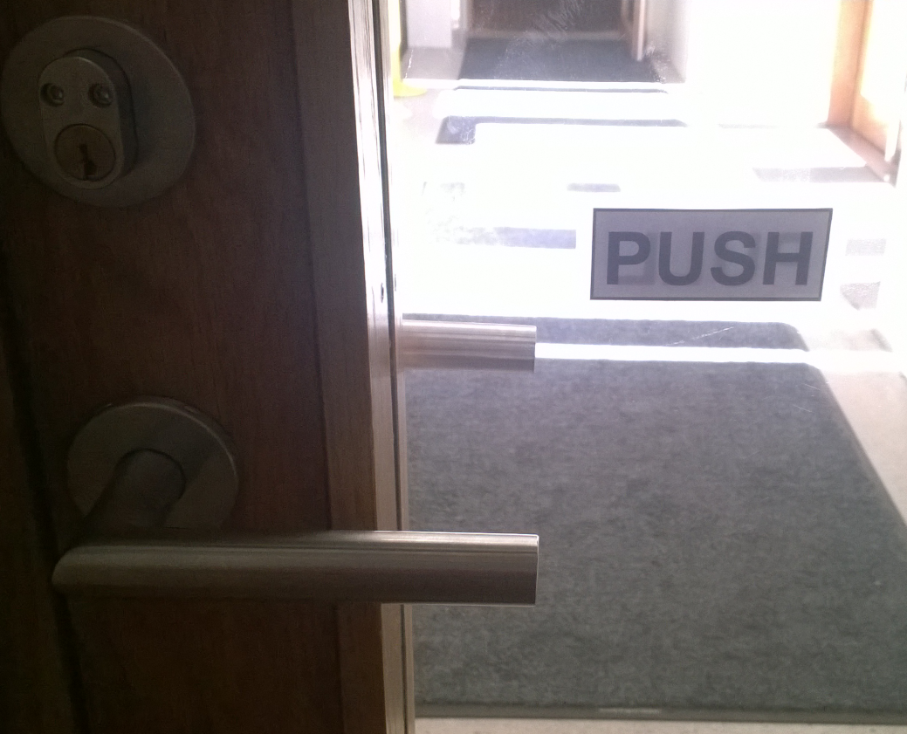
Affordance – Push Me, Pull Me
Notes:
National Museum of Architecture in Oslo, 16th June 2015, printed labels having to be added to a door because it has handles ON BOTH SIDES.
Some may find it an irony that a museum of architecture can’t install doors that don’t require additional signage.

Slide 34
Takeaways
There is more than one way of doing the same thing
Don’t provide pointless choices
Information balance - not too much, or too little
Be consistent
Surprise your users - in a good way
Make friends with your designers

Slide 35
… and
DON’T
MAKE
ME
FEEL STUPID
A. User

Slide 37
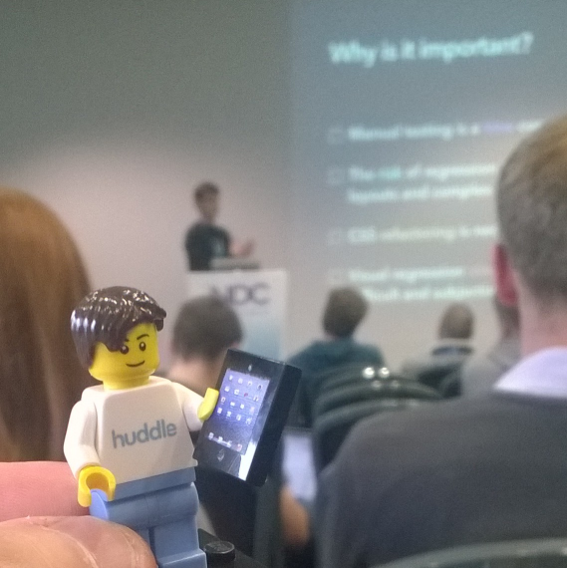
Don’t Make Me Feel Stupid A. User
Liam Westley
Application Architect
liam.westley@huddle.com
@westleyl
Notes:
Thanks to Betsy Weber (https://about.me/betsyweber) for the huddle Architect Lego mini figure.

